Slide 1


<Name>
<Date>

Slide 2

Outline
Executive Summary
Introduction
Methodology
Results
Conclusion
Appendix

Slide 3
Executive Summary
Summary of methodologies
Summary of all results

Slide 4
Introduction
Project background and context
Problems you want to find answers

Slide 5

Section 1

Slide 6
Methodology
Executive Summary
Data Was collected from SPACEX API and Wikipedia
Data was cleaned removed empty values and irrelevant data; datatypes were changed as needed
Exploratory Data Analysis was performed to check the relationship between different data in the dataset
These relationships or dependencies where visually observed
Machine Learning Algorithms where used to predict the First Stage Mission Landing Success

Slide 7
Data Collection
Data Sources:
SpaceX API for launch data
NOAA API for weather data
Public datasets for rocket specifications
Data Extraction:
API requests
Data scraping
Database querying
Data Types:
Numerical data (e.g., payload mass)
Categorical data (e.g., launch site)
Time-series data (e.g., launch date and time)

Slide 8
Data Collection – SpaceX API
https://github.com/Irtaqa007-dev/Final-Project-Submissions/blob/main/1.%20Data%20Collection%20With%20API.ipynb
+---------------------+ +--------------------+ +--------------------+
| Identify Data | | Extract Data | | Store Raw Data |
| Sources | ---> | (API, Scraping,| --->| (CSV, Database) |
| (SpaceX, NOAA, | | Querying) | | |
| Public datasets) | +--------------------+ +--------------------+
+---------------------+
+------------------------+ +--------------------+ +--------------------+
| Data Cleaning | | Integration | | Final Dataset |
| (Handling Missing | ---> | (Combine Datasets | ---> | (Ready for |
| Values, Normalizing| | on Common Keys) | | Analysis and |
| Formats) | +--------------------+ | Modeling) |
+--------------------+ +--------------------+

Slide 9
Data Collection - Scraping
https://github.com/Irtaqa007-dev/Final-Project-Submissions/blob/main/2.%20Data%20Collection%20with%20web%20Scrapping.ipynb
+---------------------+ +--------------------+ +--------------------+
| Identify Data | | Extract Data | | Store Raw Data |
| Sources | ---> | (API, Scraping,| --->| (CSV, Database) |
| (SpaceX, NOAA, | | Querying) | | |
| Public datasets) | +--------------------+ +--------------------+
+---------------------+
+------------------------+ +--------------------+ +--------------------+
| Data Cleaning | | Integration | | Final Dataset |
| (Handling Missing | ---> | (Combine Datasets | ---> | (Ready for |
| Values, Normalizing| | on Common Keys) | | Analysis and |
| Formats) | +--------------------+ | Modeling) |
+--------------------+ +--------------------+

Slide 10
Data Wrangling
Data Cleaning:
Handle missing values
Remove duplicates
Correct data types
Data Transformation:
Normalize data
Encode categorical variables
https://github.com/Irtaqa007-dev/Final-Project-Submissions/blob/main/3.%20Data%20wrangling.ipynb

Slide 11
EDA with Data Visualization
Used Cat Plot, Scatter Plot, Bar Chart, and Line Chart observe and visualize relationship between values
https://github.com/Irtaqa007-dev/Final-Project-Submissions/blob/main/5.%20Exploratory%20Data%20Analysis%20with%20Pandas%20and%20Matplotlib.ipynb

Slide 12
EDA with SQL
Loaded and previewed the dataset.
Counted total rows and columns.
Identified unique values in specific columns.
Filtered data based on specific criteria.
Aggregated data using group by and count functions.
Calculated summary statistics (mean, median) for numerical columns.
Joined multiple tables to enrich the dataset.
Ordered and limited results for specific queries.
https://github.com/Irtaqa007-dev/Final-Project-Submissions/blob/main/4.%20Data%20Exploratory%20Analysis%20SQL.ipynb

Slide 13
Build an Interactive Map with Folium
Markers were added to pinpoint launch site locations, circles to visualize safety radius, and lines to show flight paths, aiding in spatial representation and safety assessment.
Markers were added to clearly identify the exact locations of launch sites on the map. Circles were used to depict safety radii around these sites, ensuring safe distance from populated areas or boundaries. Lines were included to illustrate flight paths, providing a visual representation of the trajectory and direction of rocket launches. These objects collectively enhance spatial understanding and safety assessment for the launch operations.
https://github.com/Irtaqa007-dev/Final-Project-Submissions/blob/main/6.%20lab_jupyter_launch_site_location.ipynb

Slide 14
Build a Dashboard with Plotly Dash
Launch Site Dropdown: Allows selection of different launch sites to analyze.
Success Pie Chart: Displays either total success counts for all sites or success/failure counts for a specific site based on dropdown selection.
Payload Range Slider: Enables selection of payload ranges (kg) to analyze.
Success Payload Scatter Plot: Shows how payload mass correlates with mission outcomes (success or failure) for all sites or a specific site, with points colored by booster version.

Slide 15
Predictive Analysis (Classification)
Summarize how you built, evaluated, improved, and found the best performing classification model
You need present your model development process using key phrases and flowchart
https://github.com/Irtaqa007-dev/Final-Project-Submissions/blob/main/7.%20SpaceX_Machine%20Learning%20Prediction_Part_5.ipynb

Slide 16
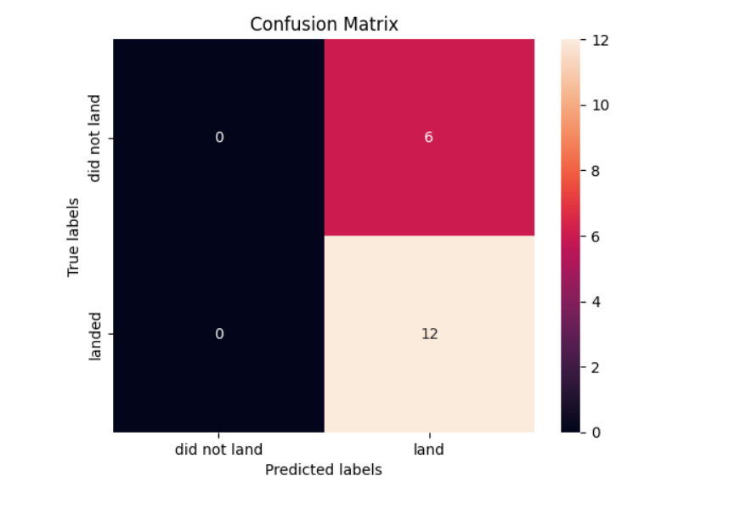
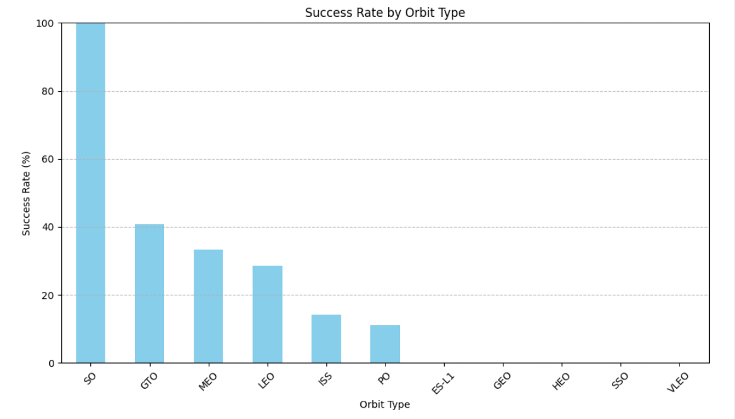
Results

Slide 17

Section 2

Slide 18
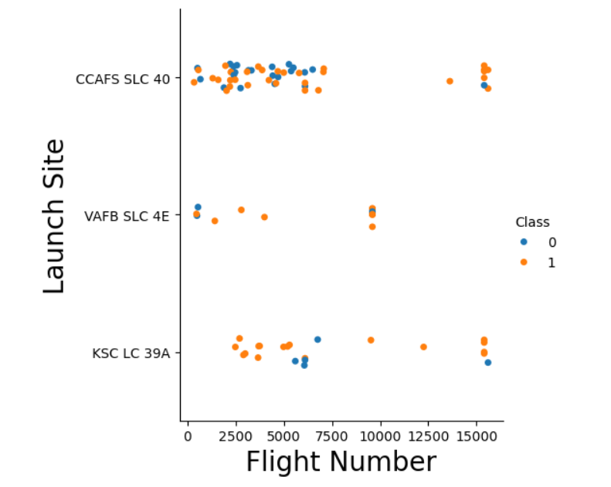
Flight Number vs. Launch Site
Show a scatter plot of Flight Number vs. Launch Site
VAFB SLC 4E does not have flights after 10000

Slide 19
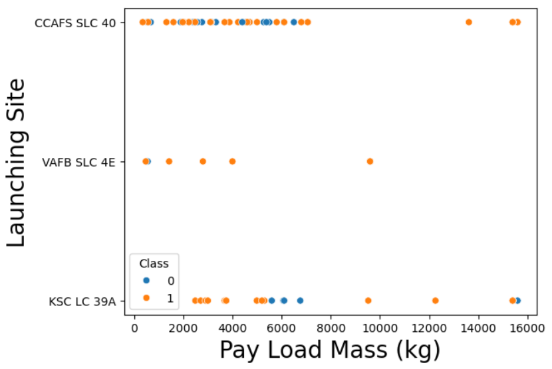
Payload vs. Launch Site
Show a scatter plot of Payload vs. Launch Site
VAFB SLC 4E had no Payload more than 10000 Kgs

Slide 20

Success Rate vs. Orbit Type
Show a bar chart for the success rate of each orbit type
SO Orbit has 100% Success rate

Slide 21
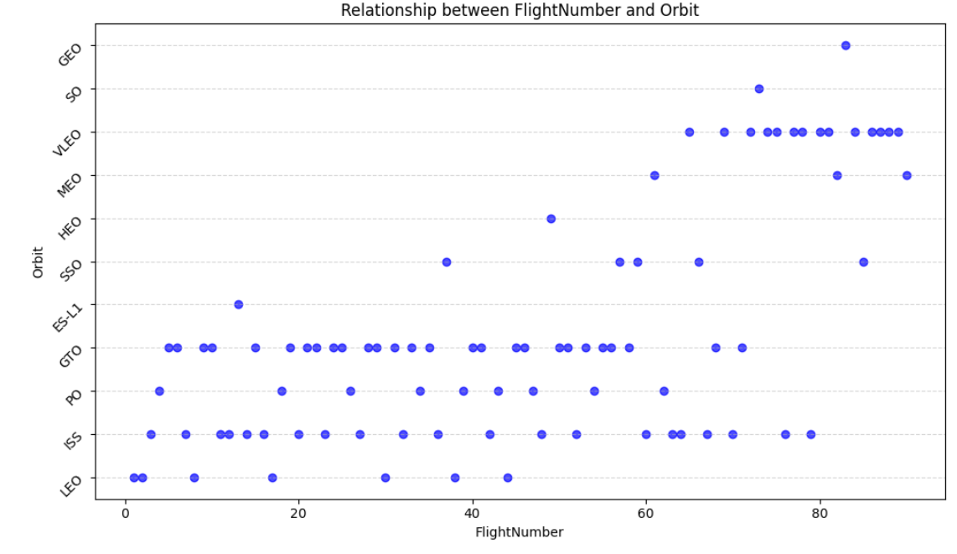
Show a scatter point of Flight number vs. Orbit type
Show the screenshot of the scatter plot with explanations
Flight Number vs. Orbit Type

Slide 22
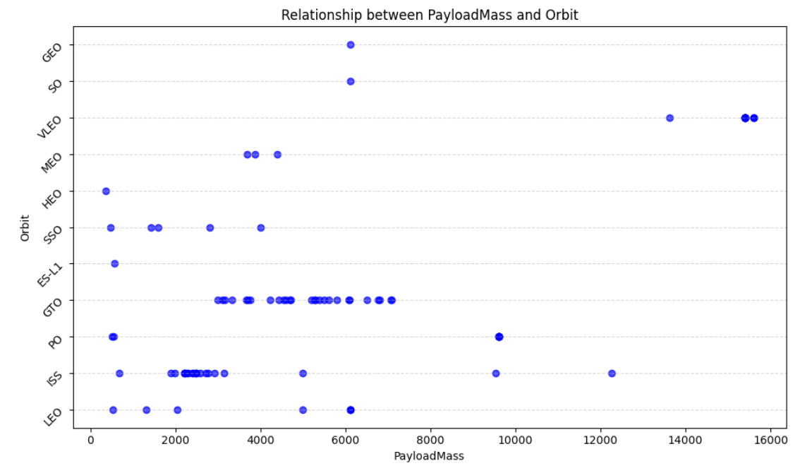
Payload vs. Orbit Type

Slide 23
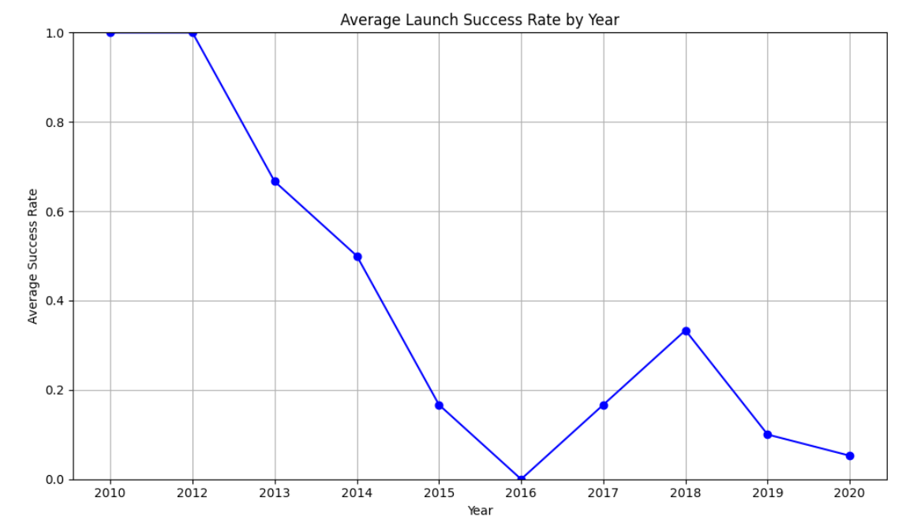
Launch Success Yearly Trend
Show a line chart of yearly average success rate
Show the screenshot of the scatter plot with explanations

Slide 24
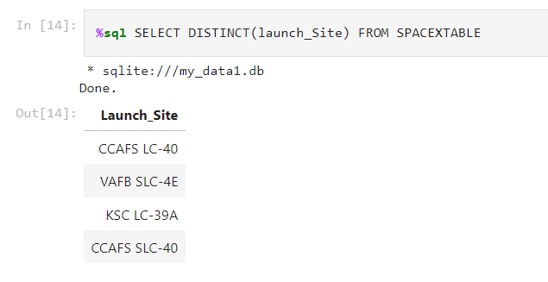
All Launch Site Names

Slide 25
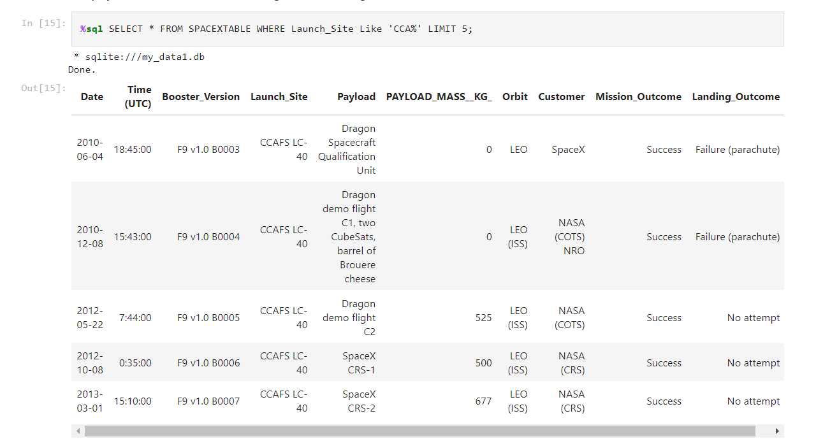
Launch Site Names Begin with 'CCA'

Slide 26
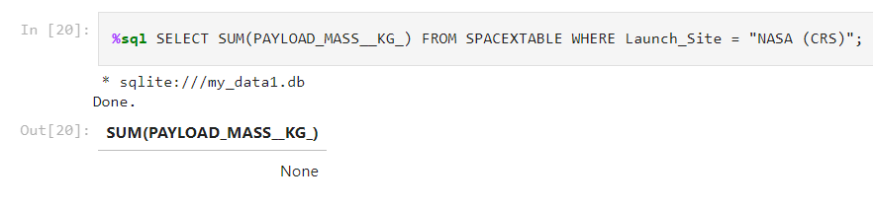
Total Payload Mass

Slide 27
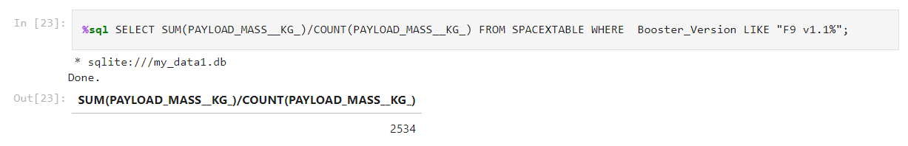
Average Payload Mass by F9 v1.1

Slide 28
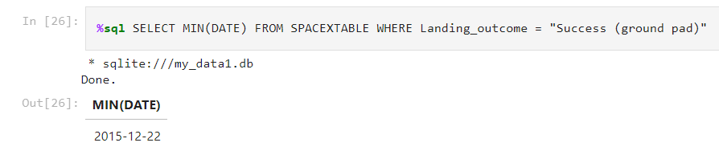
First Successful Ground Landing Date

Slide 29
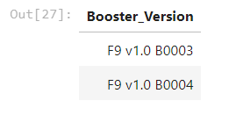
Successful Drone Ship Landing with Payload between 4000 and 6000

Slide 30
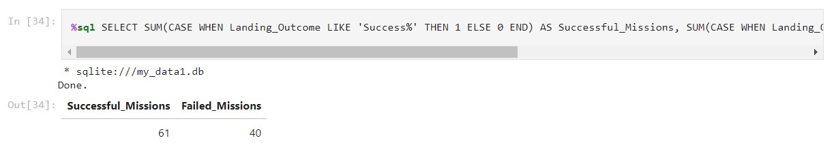
Total Number of Successful and Failure Mission Outcomes

Slide 31
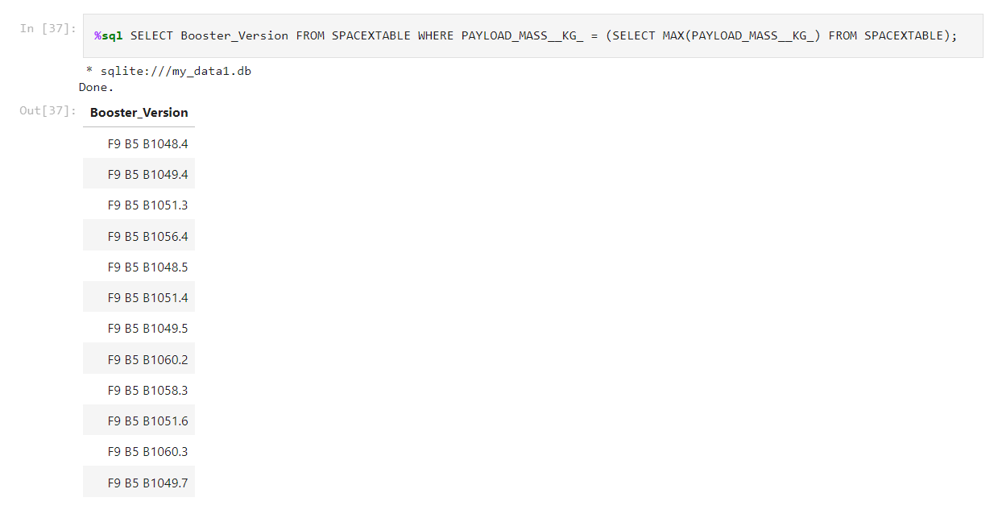
Boosters Carried Maximum Payload

Slide 32
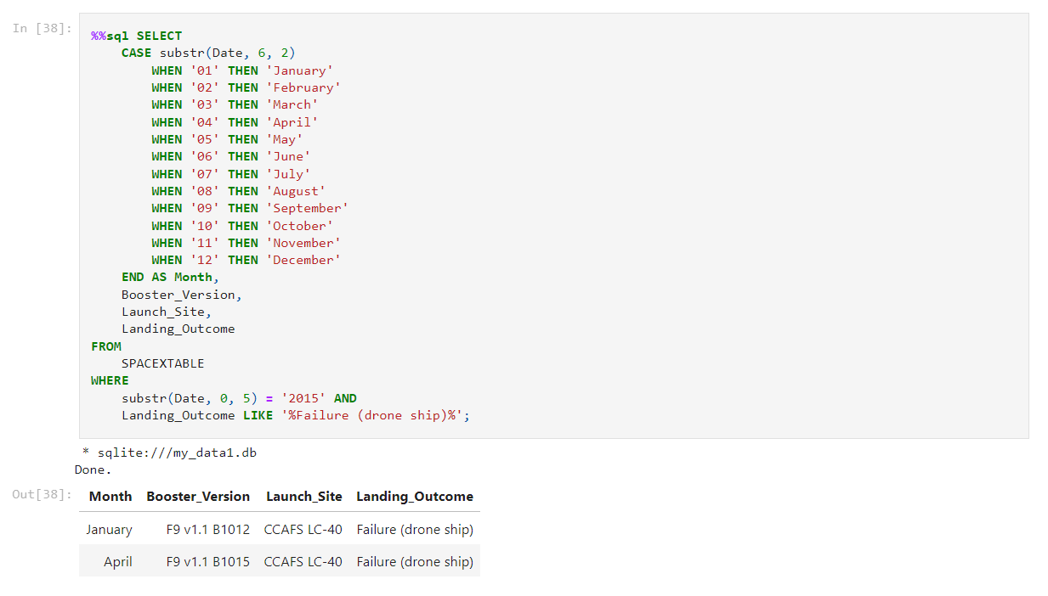
2015 Launch Records

Slide 33
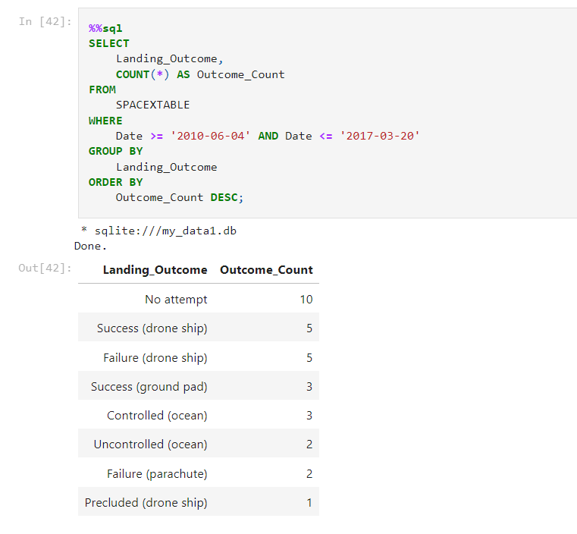
Rank Landing Outcomes Between 2010-06-04 and 2017-03-20

Slide 34

Section 3

Slide 35
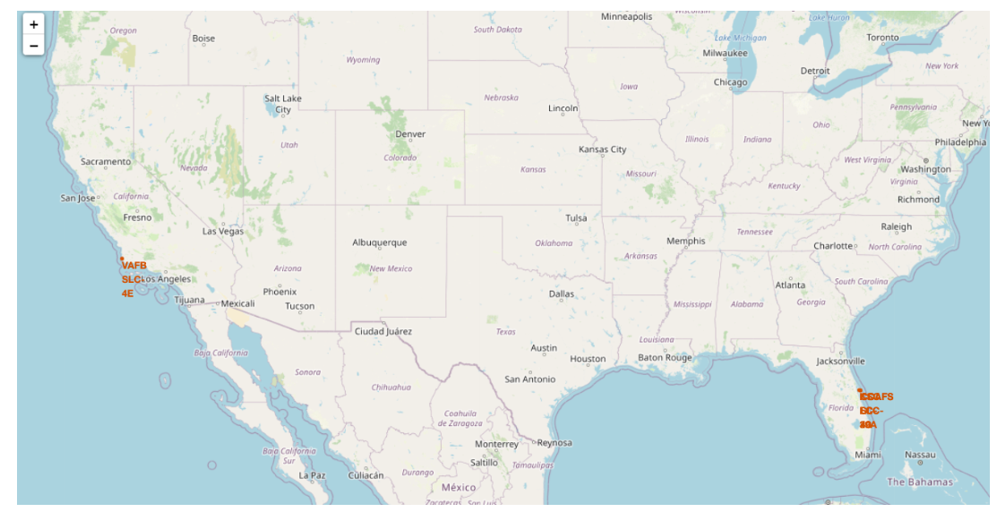
Launch Sites On Map

Slide 36
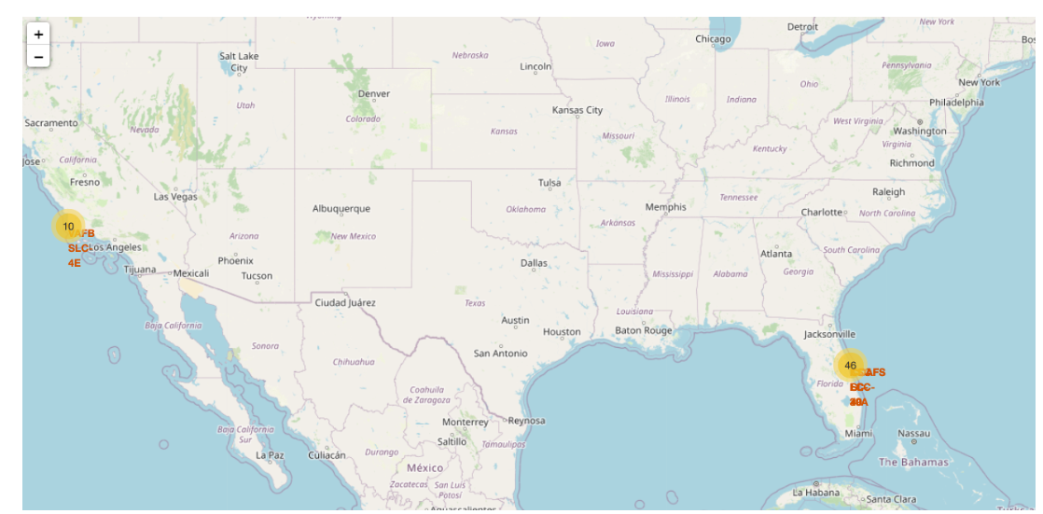
Adding Marker Clusters

Slide 37
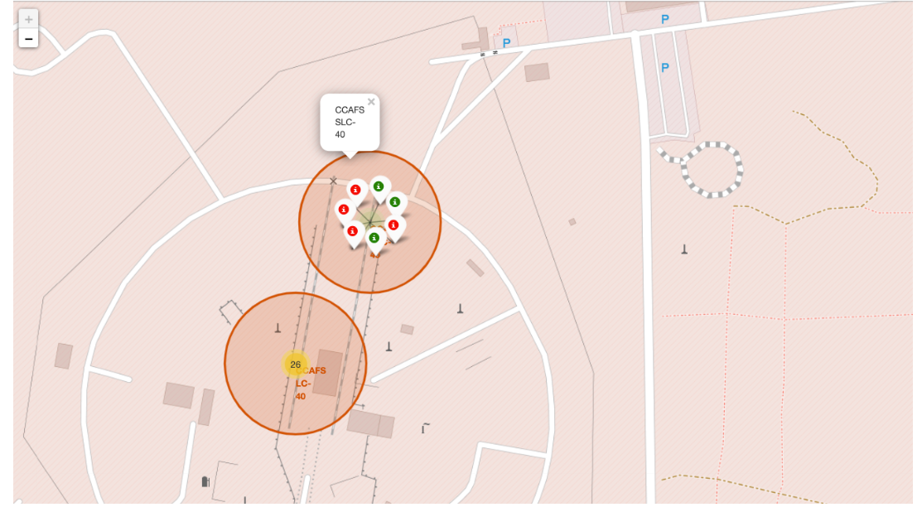
On-Click View of Successful/Failed Missions

Slide 38

Section 4

Slide 39
<Dashboard Screenshot 1>
Replace <Dashboard screenshot 1> title with an appropriate title
Show the screenshot of launch success count for all sites, in a piechart
Explain the important elements and findings on the screenshot

Slide 40
<Dashboard Screenshot 2>
Replace <Dashboard screenshot 2> title with an appropriate title
Show the screenshot of the piechart for the launch site with highest launch success ratio
Explain the important elements and findings on the screenshot

Slide 41
<Dashboard Screenshot 3>
Replace <Dashboard screenshot 3> title with an appropriate title
Show screenshots of Payload vs. Launch Outcome scatter plot for all sites, with different payload selected in the range slider
Explain the important elements and findings on the screenshot, such as which payload range or booster version have the largest success rate, etc.

Slide 42

Section 5

Slide 43
Classification Accuracy
Decision Tree Has Highest Accuracy.

Slide 44
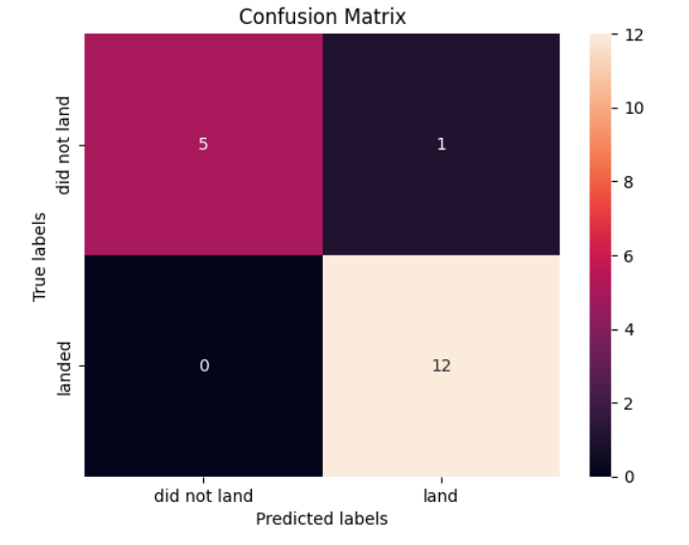
Confusion Matrix
5 True Negatives
1 False Negative
0 False Positives
12 True Positives

Slide 45
Conclusions
Point 1
Point 2
Point 3
Point 4
…

Slide 46
Appendix
Include any relevant assets like Python code snippets, SQL queries, charts, Notebook outputs, or data sets that you may have created during this project

Slide 47


